Slide 1

OVERVIEW OF RESPIRATORY ILLNESS SURVEILLANCE AND GENOMICS IN KENYA
NIC- KENYA

Slide 2
Background
Kenya has a well-established National Sentinel Surveillance System for respiratory diseases coordinated by the Ministry of Health (MoH).
The system was initially set up to monitor seasonal and pandemic influenza.
It has since expanded to include RSV and SARS-CoV-2, strengthening the ability of the country to detect outbreaks, respond to epidemics, and contribute to global surveillance efforts.
It operates a network of sentinel sites strategically located across the country to represent different ecological zones

Slide 3
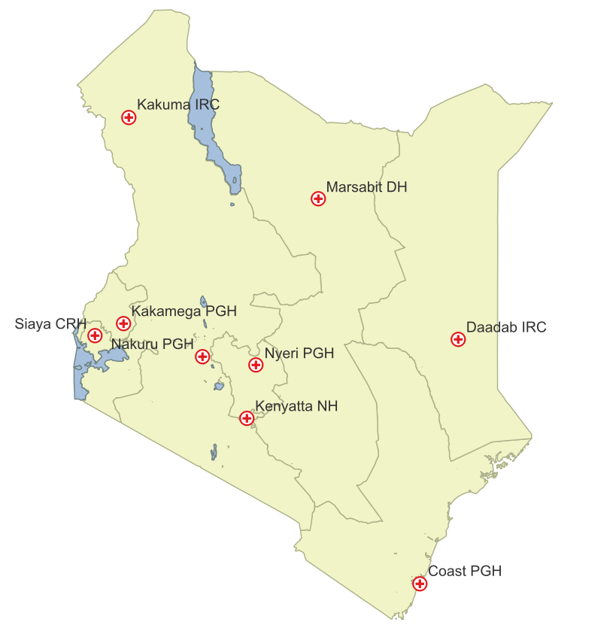
Country profile and Sentinel sites
The Kenya National sentinel surveillance system was established in 2006 by Ministry of Health with financial and technical support from US-CDC .
The programme currently conducts active surveillance in 9 sites in Kenya, 6 regional hospitals, 1 national hospital and 2 Refugee camps.
SARI/ILI surveillance is implemented in all the 9 sites, COVID-19 surveillance started in April 2020 in all sites while Extended SARI (for RSV) surveillance is being piloted on 4 sites –Nyeri CRH, Mombasa CRH, Kenyatta NH and Siaya CRH since Feb 2024.
Two more sites are in the process of being enrolled, mentorship for those sites ongoing.

Slide 4
RESPIRATORY PATHOGENS TESTING STRATEGIES

Slide 5
Introduction
The National influenza Centre (NIC) was established in 2014
Testing for Respiratory pathogens by real time (rt) RT-PCR
Primary typing of Influenza A/B and SARS CoV-2 viruses – Multiplex
Subtyping for Influenza A and genotyping Influenza B viruses
Testing for RSV and subtyping (RSV A and RSV B)
Testing of other respiratory viruses using the multiplex kit
Sequencing of a proportion of Influenza, RSV and SARS CoV-2 positive samples
Reporting on Respimat, Global Influenza Surveillance and Response System (GISRS) and GISAID
Shipping samples meeting criteria to WHO CC at CDC Atlanta

Slide 6
Specimen selection
Appropriate specimen type is key:
nasopharyngeal swabs, throat swabs, sputum, bronchoalveolar lavage, etc.
Ensure proper technique and timing to maximize the likelihood of pathogen detection.

Slide 7
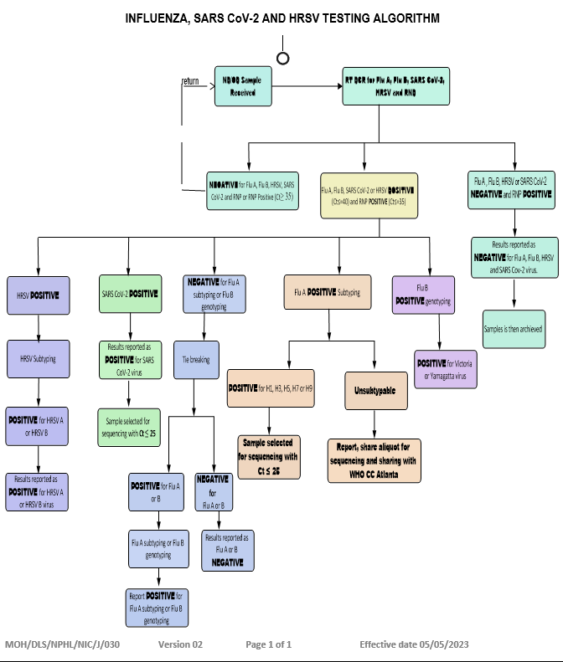

Slide 8
Sequencing Criteria

Slide 9
Respiratory expanded panel for outbreaks
From nasopharyngeal aspirate, nasopharyngeal aspirate and bronchoalveolar lavage:
Human bocavirus 1/2/3/4
Human rhinovirus A/B/C
Human coronavirus 229E, Human coronavirus NL63 and
Human coronavirus OC43
Human adenovirus,
Human metapneumovirus
Human enterovirus
Human parainfluenza virus 1/2/3/4

Slide 10
Cont…………
Chlamydophila pneumoniae,
Mycoplasma pneumoniae
Legionella pneumophila
Bordetella pertussis
Bordetella parapertussis
Streptococcus pneumoniae
Haemophilus influenzae

Slide 11
Molecular Diagnostic Methods
PCR-based assays
Real-time PCR (qPCR) – Quant Studio 5 and Biorad, Veritipro thermocycler
Multiplex PCR panels for respiratory pathogens
Next-Generation Sequencing (NGS)
Whole-genome sequencing – Use of nanoporec, Use of quia Exel and Qubit flex flurometer for QC
Metagenomic sequencing for pathogen discovery and surveillance
Molecular typing methods
Genotyping, sequencing for outbreak investigations – in progress

Slide 12
Supporting Infrastructure
Laboratory Information Management System (LIMS) – This we utilize remote data capturing and reporting
Quality Assurance systems – We perform internal QC, participate in EQA/PT schemes
Cold chain and biorepositories _ We have large for sample storage capacity

Slide 13

GENOMIC SURVEILLANCE
We leverage ONT to provide high-resolution genomic data, that we have used for public health surveillance, outbreak investigation, and precise pathogen characterization

Slide 14

The Approach
Whole Genome Sequencing (WGS)
Ligation Sequencing
Unlike targeted methods, WGS provides us with complete DNA sequence of an organisms, from one end to the other. For influenza, all the 8 segments. This provides comprehensive data for identifying all mutations, conducting precise phylogenetic analysis to track transmission chains, and detecting unexpected variants or co-infections.
It's flexible and efficient, suitable for a wide range of input DNA types and qualities.
It’s quite easy to adopt a new pathogen
This combination allows us to capture the full genomic picture.

Slide 15
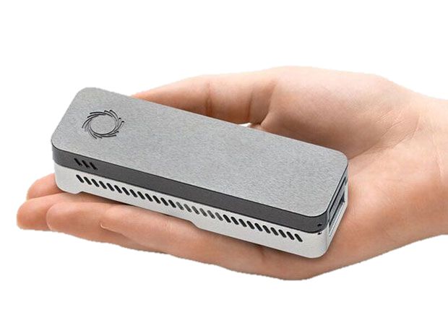
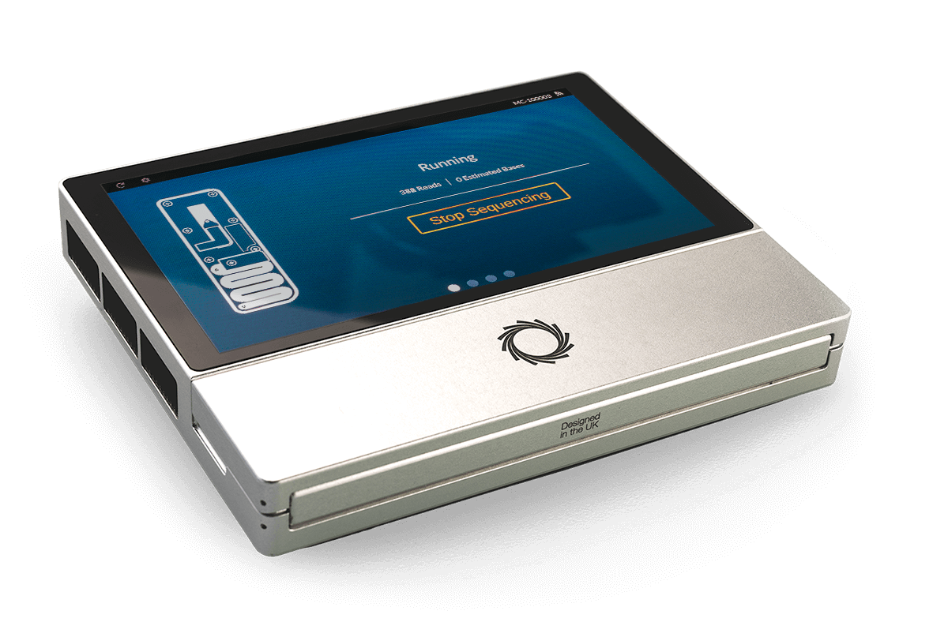
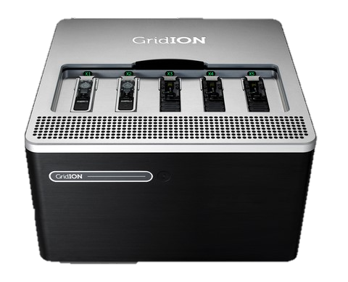
Infrastructure
At the core of our operations are 5 NGS devices, 3 dedicated to Genomics surveillance at NIC.
Strategic Access to GridION and Illumina Through our partner Genomics Lab. This enables us to scale up for larger projects, as it can run up to five flow cells simultaneously, significantly boosting throughput when needed for high-demand scenarios.
1x MinION Mk1B. This foundational, portable device offers high versatility, making it perfect for method development, pilot studies, and smaller sequencing runs. Its compact size allows for flexible deployment.
2x MinION Mk1Cs Integrated, benchtop versions of the MinION. include a dedicated compute module and touchscreen. They simplify operation and enhance stability for routine sequencing, streamlining our daily workflow.

Slide 16
Pathogens
Our laboratory actively monitors a number of respiratory pathogens, while also developing new capabilities to address emerging public health threats.
Routine Surveillance
Under Development
SARS-CoV-2: Major focus for tracking Variants of Concern (VOCs) and monitoring viral evolution.
Metagenomics: Sequencing all genetic material in a sample to detect unexpected/novel pathogens and study the microbiome.
Influenza A & B: Critical for annual vaccine strain selection by identifying antigenic drift and shift.
Respiratory Pathogen Identification Panel (RPIP): A comprehensive multiplex PCR panel to screen for a wide range of respiratory pathogens.
Respiratory Syncytial Virus (RSV): Emerging surveillance priority, especially with new vaccines and therapeutics.

Slide 17
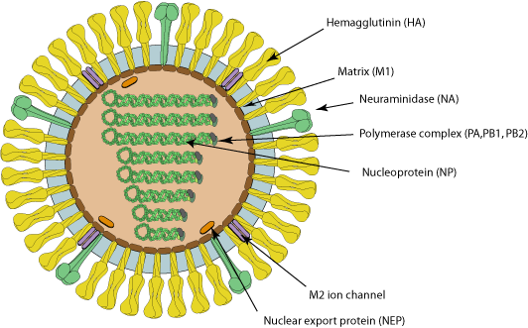


NGS Protocols:
We employ specific, optimized workflows for each pathogen to ensure maximum efficiency
and accuracy in our sequencing efforts.
01
02
03
Influenza A , B
Multisegment RT-PCR (MRT) (Ssiii, Ssiv)
Ligation based library - Chemistry 14
R10.4.1 flow cells.
SARS-CoV-2
(Midnight Protocol) ARTIC Network's "Midnight" amplicon protocol. This robust and a global standard for surveillance.
Ligation based library
RSV (Under Validation)
We are finalizing a ligation-based sequencing workflow for RSV, likely involving RT followed by the standard ligation sequencing.
Primers procurement pending

Slide 18
Supporting Infrastructure:
Our supporting infrastructure includes; computers, internet, LAN and storage. They ensure seamless data flow and efficient operations.
Primary computer:
Dell XPS 8950:
Core i9-12900K, 64Gb RAM,
GPU (Nvidia RTX 4060Ti). Quite handy in basecalling
1Tb SSD 8Tb HDD.
Network Capabilities
Internet: 100 Mbps symmetrical fiber connection,
LAN: 2.5 Gigabit Ethernet, enabling fast transfer of large sequencing files between computers and to a potential future network-attached storage (NAS) device.
Secondary Computer
Dell OptiPlex
Core i7-12700, 32GB RAM,
GPU (RTX 2080 Super).
2 x 512 Gb SSDs

Slide 19
Sequencing Ecosystem:
Tools, Advancements, and Practices
Our comprehensive software ecosystem enables genomic data analysis from sequencing to interpretation:
Core Software
Specialized Platforms
MinKNOW - controls the sequencer and performs live basecalling.
MIRA - QC checks and assembly.
GISAID for sharing influenza and coronavirus data, with integrated tools like FluServer and Auspice for real-time phylogenetic analysis.
Docker Desktop & WSL/Ubuntu: These create a containerized and Linux-native environment on Windows. This is essential for running bioinformatics tools that are built for Linux.
ANACONDA: A package and environment manager for Python. We are developing its use for the Command Line Interface (CLI) to manage complex bioinformatics pipelines, allowing for more customizable and automated analyses.
Analysis Tools
EPI2ME user-friendly GUI based automated workflows
Jalview: Specialized tools for visualizing multiple sequences, alignment, analyzing conservation, editing etc.
MEGA for constructing phylogenetic trees, performing sequences alignment etc.

Slide 20
Key Developments
Our strategic growth has been driven by several critical improvements:
Migration to Chemistry 14 + R10
Flongle Workflow Development
In-House Computing
Moving from legacy chemistry improved our raw accuracy. This directly improves data quality, simplifies analysis, and increases confidence in results.
Adapting protocols for smaller, cheaper flow cells. Ideal for sequencing smaller number of samples.
Cost-effective, perfect for rapid confirmation or small-scale projects.
In-house analysis on a dedicated computer has drastically reduced the need for cloud-based computing and ensures more control on our data.
Enhanced Batch Processing
Continuous Training
Multi-channel pipettes and magnetic plate rack have made NGS wet-lab processes quite efficient. Handling multiple samples reduces TAT and reduces time of exposure to the environmental elements.
In-house knowledge sharing
Continuous Training on NGS Quality Control
Training on CLI for bioinformatics

Slide 21
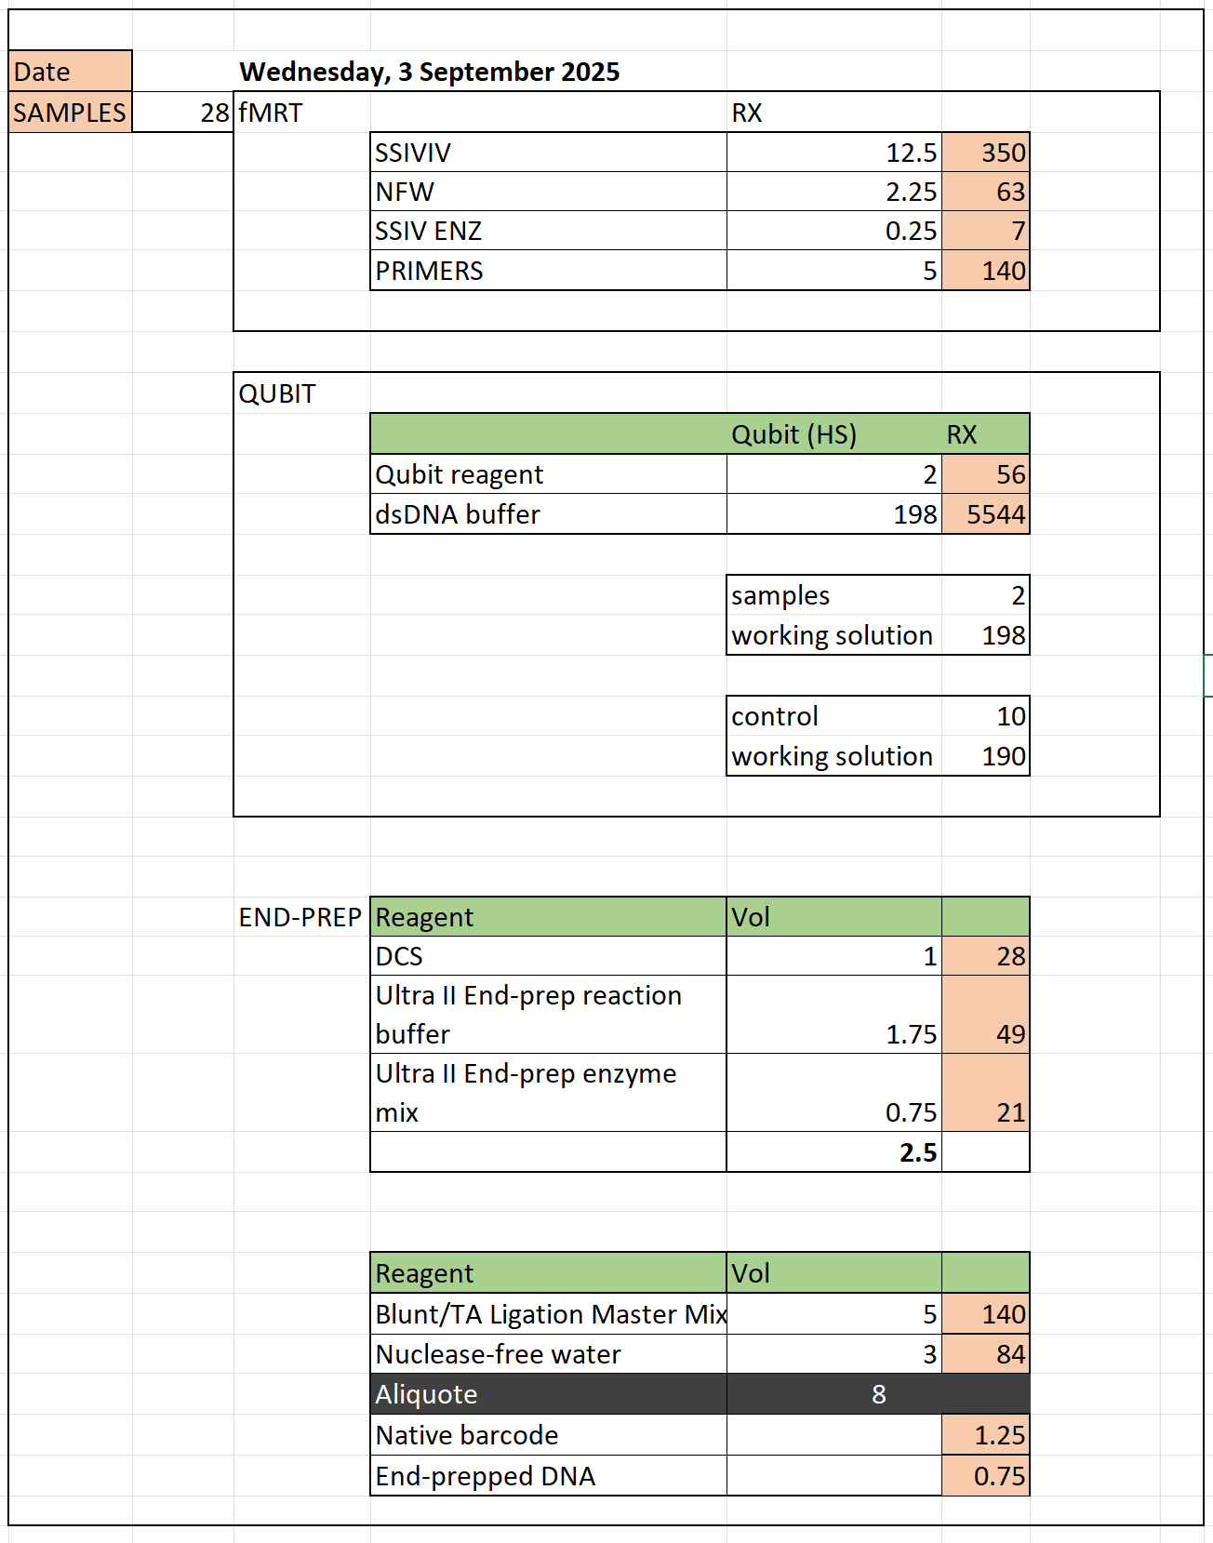
Good Practices
Our commitment to providing quality sequences and genomic information pushes us to innovate and improve what we have.
QC Steps
1. PCR Ct Value Assessment
Reagents Calculator
We assess starting Ct values to generally predict better sequencing success.
2. Qualification and quantification
Qubit
DNA quantification after MRT, barcode ligation, and adapter ligation to ensure optimal concentration.
Electrophoresis - QiaXcel
provides digital gel images to confirm size, quantity, and purity of amplicons.
Controls & Electrophoresis
Every run includes positive and negative controls.
3. Pipeline Validation
We periodically validate our bioinformatics pipeline by running sequences of known character (WHO – EQA)

Slide 22
DATA MANAGEMENT

Slide 23







Flu surveillance data flow
Results are sent to the SARI site
SARI SITE
NPHL NIC
CDC KEMRI
Transport for specimens and specimen referral log
LIMS Reception
KEMRI SARI System
Requests API
Transfer of EPI data through the networks
Tasks
1. Patient EPI Data collected on the Net Books
2. Sample request form filled
LIMS DB
Tasks
1. Data sorting and verification
2.. Sample Requests Sent to NIC through an API
Tasks
1 . Receive Specimen and specimen request data
2. Aliquoting of the primary sample into 3 vials
3. Test and Review results
4. Send Test results to Both KEMRI-CDC (Via API) and Email Results back to the SARI sites.
5. Generate reports for weekly report FluMart (Flu ID and Flu net) and GSAID
Results API

Slide 24
Interpretation of results
The clinical context and pre-test probability when interpreting results.
Be aware of potential false positives/ negatives, especially in the context of high or low prevalence of a pathogen

Slide 27
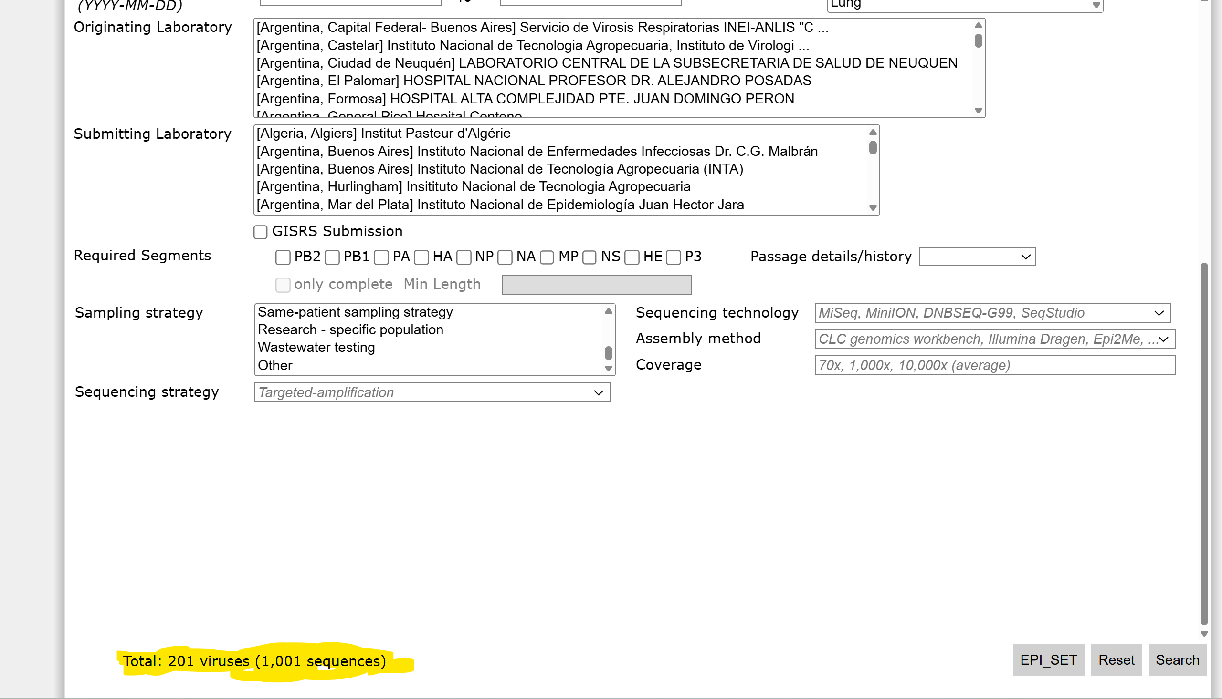

Slide 28
Achievements
Introduction of multiplex which will enable the NIC cover a wide range of organisms
Introduction of sequencing to the testing scope.
We were proud that our sequences are captured into the GSAID data base.
Patients are able to receive their results for treatment
Remote logging by the sentinel sites

Slide 29

Challenges & Mitigation Strategies
Cost & Sustainability
Genome Completeness
ONT reagents and flow cells represent significant recurring costs. We're developing cost-saving workflows (e.g., Flongle) and seeking support from partners and GoK.
Achieving 100% coverage for all 8 influenza segments can be challenging. I want to pick your thoughts and techniques in this one.
Influenza Seasonality
Human Resources
Unpredictable workloads can challenge available human resource. We developed a sequencing criteria to help during high season.
NGS requires rare skills in molecular biology, bioinformatics, and data interpretation. We address this through continuous internal training.
Procurement & Supply Chain Challenges
Customs delays for reagents – we try our best to initiate procurement well in advance
Global supply chain issues can lead to stock-outs - we try to order surplus.
Rapid innovation can block use of legacy reagents – eg R9 flow cells

Slide 30


